Slide 1

CSE 464 : Software Quality Assurance and Testing
Introductory Lecture
Janaka Balasooriya

Slide 2
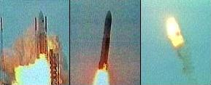
Why Software Quality Matters?
Avoid software malfunctions (possibly disasters)
https://www.youtube.com/watch?v=gp_D8r-2hwk

Slide 3
Why Software Quality Matters?: Another way to look !
“If the automobile industry had developed like the software industry,” the mogul proclaims, “we would all be driving $25 cars that get 1,000 miles to the gallon.” To which an automobile executive retorts, “Yeah, and if cars were like software, they would crash twice a day for no reason, and when you called for service, they’d tell you to reinstall the engine.”
Why Software Is So Bad, by Charles C. Mann July 1, 2002

Slide 4
Infamous Software Failures Due to Bad Quality – A Closer Look

Slide 5
Disney’s “Lion King”, the 1st multimedia CD-ROM
  During Christmas – sales expectations very huge
  Customer Service phones began to ring as many customers couldn't run watch the movie.
  Failure to properly test SW on many different PC models
    Worked well on the models that Disney programmers used to create the game !!
Taken From “Software Testing” by Ron Patton

Slide 6
A Medical Software Example: Quality and Risk
“People bet their jobs, their comforts, their safety, their entertainment, their decisions, and their very lives on computer software. It better be right.” SEPA, Chapter 1
Example:
  Throughout the month of November, 2000 at a hospital in Panama, 28 patients received massive overdoses of gamma rays during treatment for a variety of cancers. In the months that followed, five of these patients died from radiation poisoning and 15 others developed serious complications. What caused this tragedy? A software package was modified by hospital technicians to compute modified doses of radiation for each patient.
http://www.wired.com/software/coolapps/news/2005/11/69355?currentPage=2

Slide 7
Ariane 5 Failure
A software bug caused European Space Agency’s Ariane 5 rocket to crash 40 seconds into its first flight in 1996 (cost: half billion dollars)
The bug was caused because of a software component that was being reused from Ariane 4
A software exception occurred during execution of a data conversion from 64-bit floating point to 16-bit signed integer value
  The value was larger than 32,767, the largest integer storable in a 16 bit signed integer, and thus the conversion failed and an exception was raised by the program
When the primary computer system failed due to this problem, the secondary system started running.
  The secondary system was running the same software, so it failed too!

Slide 8
Ariane 5 Failure
The programmers for Ariane 4 had decided that this particular velocity figure would never be large enough to raise this exception.
  Ariane 5 was a faster rocket than Ariane 4!
The calculation containing the bug actually served no purpose once the rocket was in the air.
  Engineers chose long ago, in an earlier version of the Ariane rocket, to leave this function running for the first 40 seconds of flight to make it easy to restart the system in the event of a brief hold in the countdown.
You can read the report of Ariane 5 failure at:
http://www.ima.umn.edu/~arnold/disasters/ariane5rep.html

Slide 9
Several Other “high profile” Software Failures and Impact
Security bug in the open-source OpenSSL cryprography library Heartbleed
Measuring error in Olympic games Hammer throwing, London, August 2012
Software bug leads to retardation of brake system Delay in admission of new ICE trains, November 2012
Curiosity mars rover bug NASA fixes bug, March 2013,
Software update leads to erroneous orders at Stock Exchange: Knight Capital looses $389 million, August 2012
Boing Max 777 Crash (2019): https://www.theverge.com/2020/4/9/21197162/boeing-737-max-software-hardware-computer-fcc-crash
https://www.it-cisq.org/press-releases/12-06-22/ (CISQ Cost of Poor software quality report - 2022)

Slide 10
Computer Engineers and Scientists have a big responsivity to Design, Develop, and Release better quality Software

Slide 11
Course Objectives/Outcomes class website: my.asu.edu
By the end of this course, students should be able to
  explain fundamental SQA considerations and understand the role of testing in SQA
  explain the basis of various approaches in unit, integration, and system testing
  understand how testing is applied throughout the software life cycle
  able to use an automated testing tool to write test cases and perform testing
  carryout test driven development for complex software using testing tools
  able to perform inspections, reviews, and walkthroughs of code and design of a large software system
  explain basic principles of software configuration management
  gain a solid understanding of state of the art in software testing
Above objectives will be met by following
  The Course Syllabus and Tentative Schedule

Slide 12
Assessment and Grading
Homework/Project Objectives: Apply testing, configuration management and quality control techniques in software development process. Use appropriate tools in testing, test documentation, and configuration management.
Homework/Projects - 40%
Quizzes and Class Activities - 15%
Midterm I – 12.5%
Midterm II – 15%
Final Exam – 17.5%
Final Grade | Percentage
A+ | >= 97%
A | >= 90% and < 97%
B+ | >= 87% and < 90%
B | >= 80% and < 87%
C+ | >= 77 and < 80%
C | >= 70% and < 77%
D | >= 60% and < 70%
E | < 60%

Slide 13
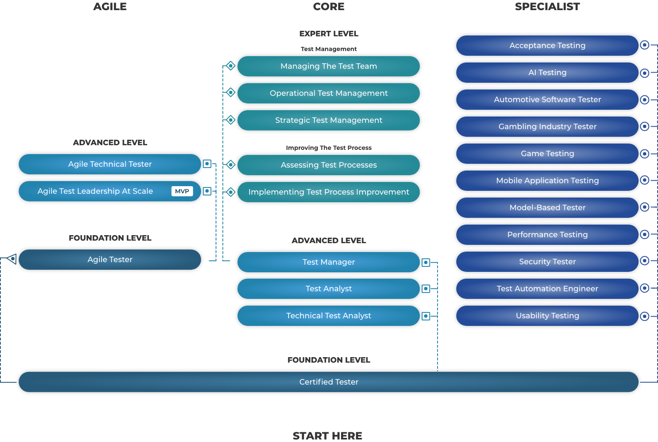
ISTQB & CSE 464
CSE 464 covers The International Software Testing Qualifications Board (ISTQB)https://www.istqb.org/ professional tester certification foundation level

Slide 14
Homework: Reading Assignment
Read the articles “WhySoftwareIsSoBad” and “The Boeing 737 MAX Saga: Lessons for Software Organizations” posted with this lecture note

